Slide 1
Understanding Electron and Modern Web Rendering Tools: A Learning & Analytical Perspective

Slide 2
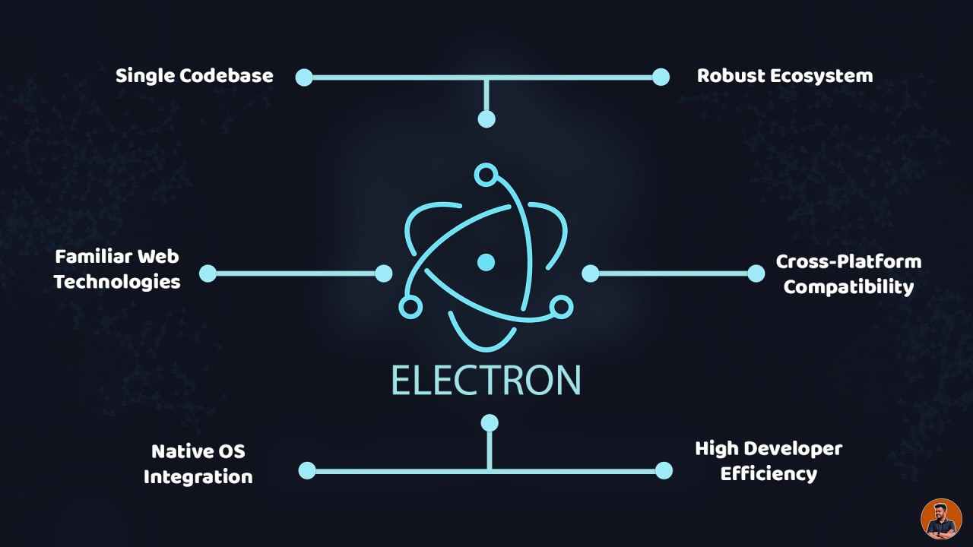
Learning Outcomes of This Tutorial
By the end of this tutorial, learners will be able to:
Remember the core ideas behind Electron, WebGL, WebGPU, and three.js
Understand the purpose and architecture of cross-platform runtimes
Apply basic Electron setup to build a desktop app
Analyze benefits and limitations of Electron vs native frameworks
Evaluate rendering technologies (WebGL vs WebGPU vs three.js)
Create a simple cross-platform UI using web technologies

Slide 3
What Learners Will Understand After the Tutorial
Students should walk away with a basic understanding of:
History of Electron & web rendering (WebGL/WebGPU standards)
The problems these technologies solve (write once → run anywhere)
Benefits: fast development, large ecosystem, cross-platform reach
Challenges: memory usage, performance overhead, security concerns
Future directions: WebGPU adoption, lightweight runtimes
Basic implementation skills from our Higgs Electron project

Slide 4
History of Electron, WebGL, WebGPU, and three.js
Electron
(2013 – GitHub)
WebGL (2011 – Khronos Group)
three.js (2010 – Community Project)
Built by GitHub to enable desktop apps with web tech (HTML/CSS/JS)
Combines Chromium + Node.js
Used in VS Code, Slack, Discord
Built on standard web technologies
JS API for in-browser 2D/3D graphics
Based on OpenGL ES 2.0
Hardware-accelerated rendering
Supported by all major browsers
Open-source 3D graphics library
High-level wrapper around WebGL
Provides cameras, lighting, materials, scenes
Adding support for WebGPU

Slide 5
Standards & Specifications
WebGL Standards (Khronos Group)
WebGL 1.0 (2011) — Based on OpenGL ES 2.0
WebGL 2.0 (2017) — Based on OpenGL ES 3.0
Standardized by the Khronos Group
WebGPU Standards (W3C)
WebGPU (2023) — Modern graphics & compute API
Standardized by W3C GPU for the Web WG
Aligns with Vulkan, Metal, D3D12

Slide 6
Standards & Specifications
Electron & three.js
No formal standards bodies
Electron: Maintained by GitHub + community
three.js: Community-driven; built on WebGL/WebGPU best practices
References
Khronos Group: WebGL Specification
W3C: WebGPU Specification
GitHub: Electron Documentation
three.js Project Documentation

Slide 7
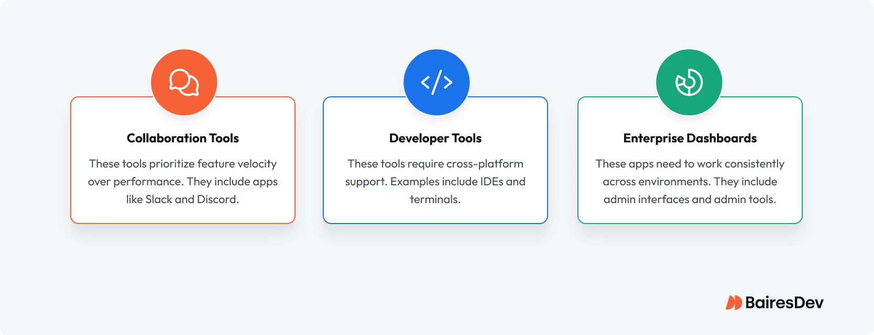
Our Team’s Opinion on the Technology
Our evaluation of Electron + WebGL/WebGPU/three.js:
Electron is highly practical for real-world apps needing cross-platform reach
three.js is the most accessible library for 3D visualization
WebGL is stable and mature; WebGPU is the future of high-performance graphics
Combining these gives developers tremendous flexibility with minimal overhead

Slide 8
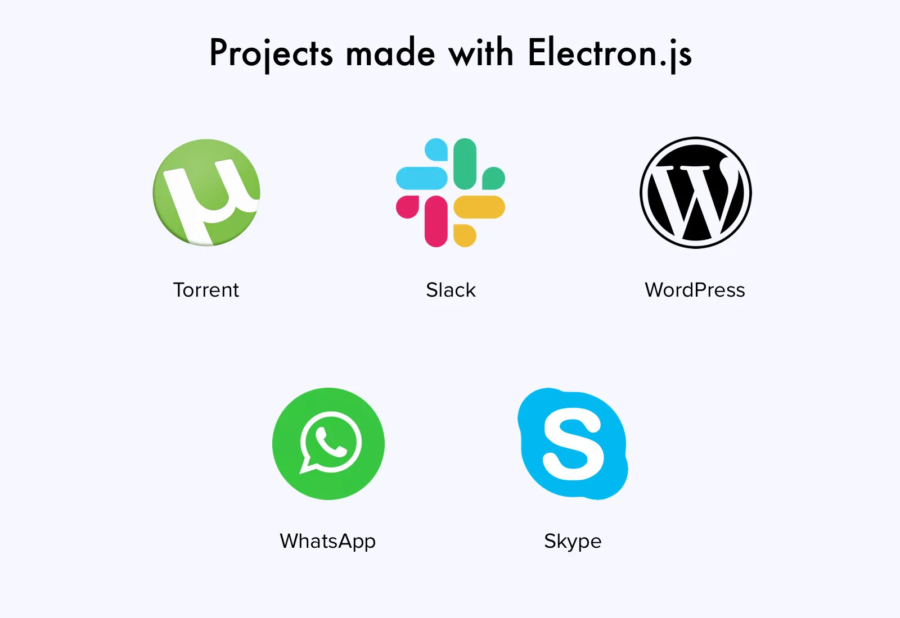
Strengths of the Technology
Fast development speed using HTML/CSS/JS + npm ecosystem
Works on Windows, macOS, Linux without extra code
Proven in industry: VS Code, Slack, Discord
Easy integration with rendering engines (WebGL / WebGPU)
Our Higgs project proved Electron is ideal for productivity + dashboard tools

Slide 9
Challenges and Weaknesses
Higher RAM and CPU usage than native apps
Large bundle size (Chromium included)
Not optimal for real-time 3D without WebGPU
Security risks if Node integration is not handled properly
Packaging and signing apps can increase complexity

Slide 10
Final Analytical Conclusion
Electron remains the best practical choice for cross-platform desktop apps
Performance trade-offs are acceptable for most use cases
WebGPU will significantly improve graphical performance in the future
Electron + modern rendering frameworks → powerful toolset for developers
Our project experience (Higgs) confirms these technologies are efficient, scalable, and beginner-friendly

Slide 11
Thank you!

